Slide 1
Ingest and transform data in Microsoft Fabric
Module 7

Slide 2
Understand data load design goals
Where is my data coming from?
Is the data net new? or do you receive changes from existing datasets?
How often is the data being refreshed, added to or replaced?
What formats are the data coming in?
Is the data ingestible as-is? or are transformations and cleansing tasks required?
Which takes priority, loading or querying/analysis?
Notes:
While Fabric does have shortcuts to reduce data movement, you will often still want to ingest and transform data. Before you begin this tasks you will want to ask yourself several questions to understand the requirements.
These requirements will help you choose the best tool for the job, since Fabric offers many options for data ingestion and transformation.

Slide 3
Automated Data Ingestion and Transform Options
Main options:
Data pipelines (and copy tool)
Dataflows
Spark notebook
Other options for data warehouse destinations
COPY (T-SQL) for warehouses
Cross-warehouse ingestion (T-SQL)
Notes:
Microsoft Fabric offers many ways to ingest and transform data. While certain tools may work best in certain situations, you can often choose the tool with which you are most comfortable. In this module, we’ll discuss the details of each option and when each may be most appropriate
These options are available to load batch data into OneLake, Lakehouses, or Warehouses
Data pipelines are part of data factory. You can build a pipeline yourself or use the Copy Assistant.
Dataflows use Power Query to ingest and transform your data, then land it in a lake, warehouse, or lakehouse
Spark notebooks use the Spark engine with your language and library choice to extract, transform, and load data
For data warehouses in Fabric, you can also use the T-SQL command COPY INTO to load files into the warehouse. Or if the data you need already resides in another warehouse in the same workspace, you can perform cross-warehouse ingestion using T-SQL commands such as SELECT…INTO or CTAS.
We have individual modules with labs to help you learn HOW to use the three main options. In this module, we’ll talk about how to choose the best option for your use case and how to schedule these options with the tools available in Fabric.

Slide 4
Do You Need Complex Transformations?
Just Copy
Copy tool
Some Transforms
Data Pipeline
Complex Transforms
Spark Notebook
T-SQL
Dataflow
Notes:
Some tools in Fabric are only for copying while others are good for transformations or both.
The Copy tool is a highly scalable Data Integration solution that allows you to connect to different data sources and load the data either in original format or convert it to a Delta table. But outside of changing the output format, you can’t do actual data transformation.
Using the copy tool results in a data pipeline with a copy activity. Data factory does support some control flow activities that do some minor data transformation (filter, lookup, getmetadata), but it’s largely used as an orchestration tool that calls other tools like dataflows, T-SQL stored procedures, and Spark notebooks to do transformation work.
Dataflows use Power Query to perform data transformation. Power Query has many helpful options for transforming data, but it still somewhat limited.
T-SQL is commonly used to transform data, but there are limits, especially when parsing non-tabular datasets.
Spark Notebooks are able to perform both simple and complex transformations of data whether structured or semi-structured.

Slide 5
How Much Code Do You Want To Write?
No code
Copy tool
Low Code
Dataflow
Data pipeline
High code
T-SQL
Spark Notebook
Spark Job Definition
Notes:
Your choice of data processing tool may depend on your skills or desire to write code. If you prefer a low-code experience and just want to copy data, you might opt for the copy tool in a data pipeline.
If you need to perform more transformation in a low-code environment, dataflows may be the best solution.
If you want to copy with a bit more configuration and use of expression language, you can use a data pipeline with copy activity.
If you are comfortable with T-SQL, you may use it to transform and load data into a warehouse.
If you know Python/PySpark, R, Java, or Scala you may be most comfortable with a Spark notebook or Spark job definition.

Slide 6
How Big Is Your Data?
Small
Dataflows
Large
Copy tool
Any/ Depends
Notebook
T-SQL
Copy activity
Notes:
Size is a consideration when choosing the appropriate tool to process your data.
You would notice a large performance difference between a dataflow and a pipeline copy activity that perform the same task when you are working with large data sizes.
Spark was originally built as a big data engine, so it can also handle large sizes, but is not limited to large data sizes. T-SQL can also be used on both large and small data. Performance may vary based upon the situation.

Slide 7
Options for Scheduling Your Data Processing
Copy activity
Dataflow schedule refresh
Data pipeline
Spark
Spark Job Definition
Data pipeline
Data Pipeline
T-SQL scripts
Data Pipeline
Dataflow
Notes:
While some items in Fabric can be scheduled on their own right from the item, it is common to use a data pipeline to orchestrate data loading activities. It can often be useful to use the pipelines to schedule important enterprise data processing or to have visibility to all related scheduled data processing activities by using a pipeline.
For specialized or departmental workloads, some users may want to schedule a dataflow or a Spark job without using a data pipeline.
For data processing in Spark, you can schedule a notebook using a data pipeline. Or you can use a Spark Job Definition, which does not necessarily involve a notebook.
We’ll go the basics of each of these items and their scheduling next.

Slide 8
Copy Tool/Copy Activity

Slide 9
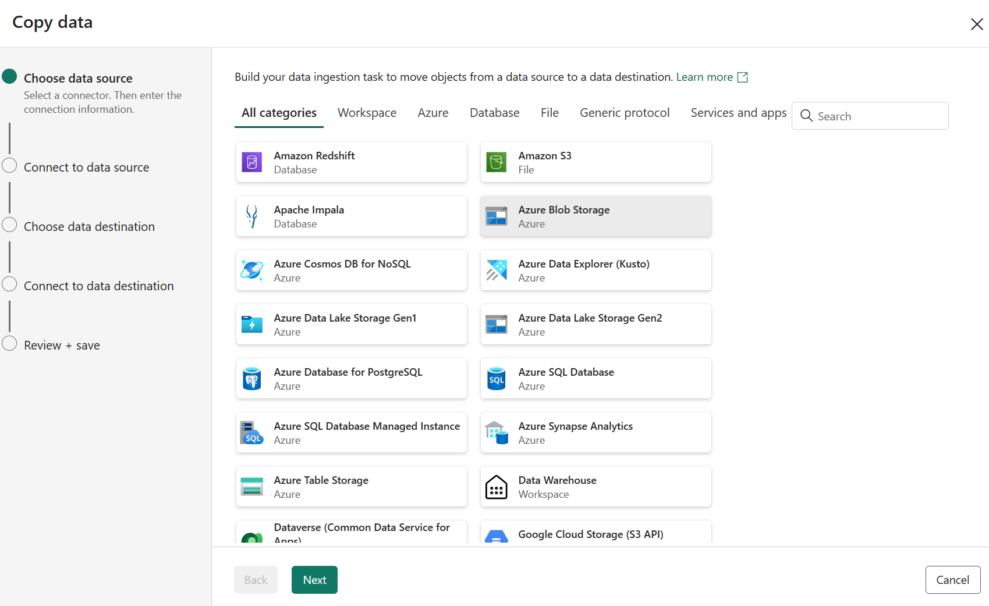
Copy data tool
Notes:
In a data pipeline, you can add a copy activity to copy data among data stores located in the cloud. While you can add the copy activity directly to a pipeline, there is also a wizard, referred to the copy data tool, that can help set this up. This is the easiest entry point for those not familiar with data factory.
To use the copy tool, create or open a pipeline, and select Use copy assistant from the Copy data drop down list under the Activities tab on the ribbon. You’ll then be asked to configure the source and destination. You can also map columns from source to destination when needed.

Slide 10
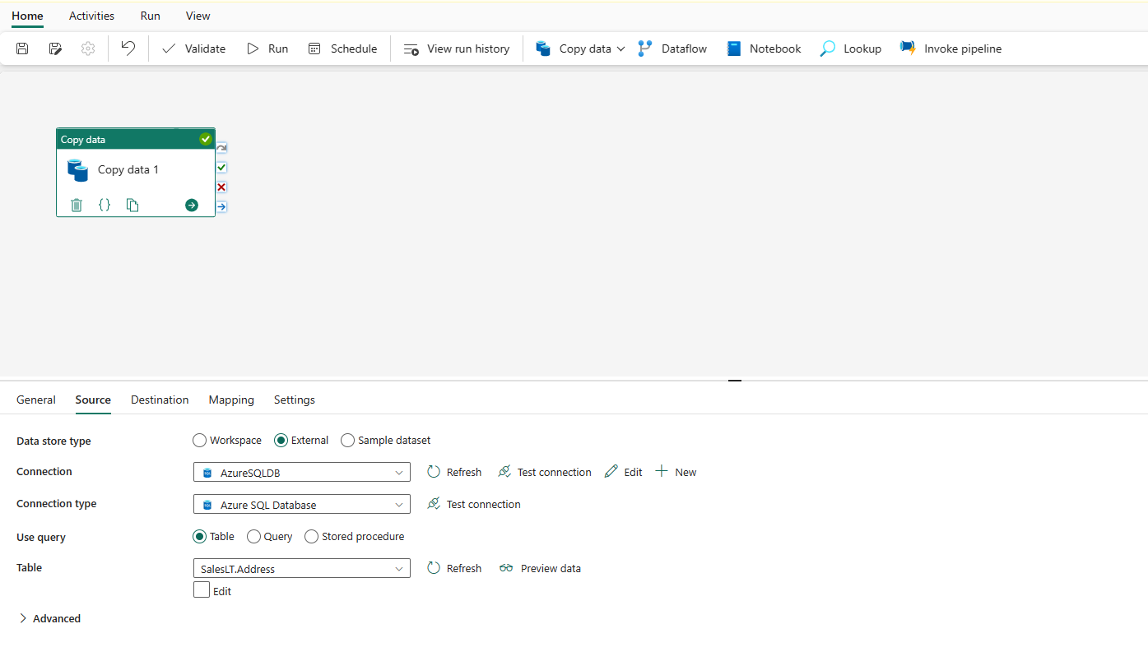
Copy Activity
Notes:
In a data pipeline, you can directly add a copy activity either by selecting Add pipeline activity > Copy activity or by selecting Copy data > Add to canvas under the Activities tab
You’ll then set some general properties for the copy activity, followed by the source and destination.
Copy activities can be parameterized to become reusable across multiple files or tables from the same source. You can also add other activities to the pipeline as part of an orchestration process.

Slide 11
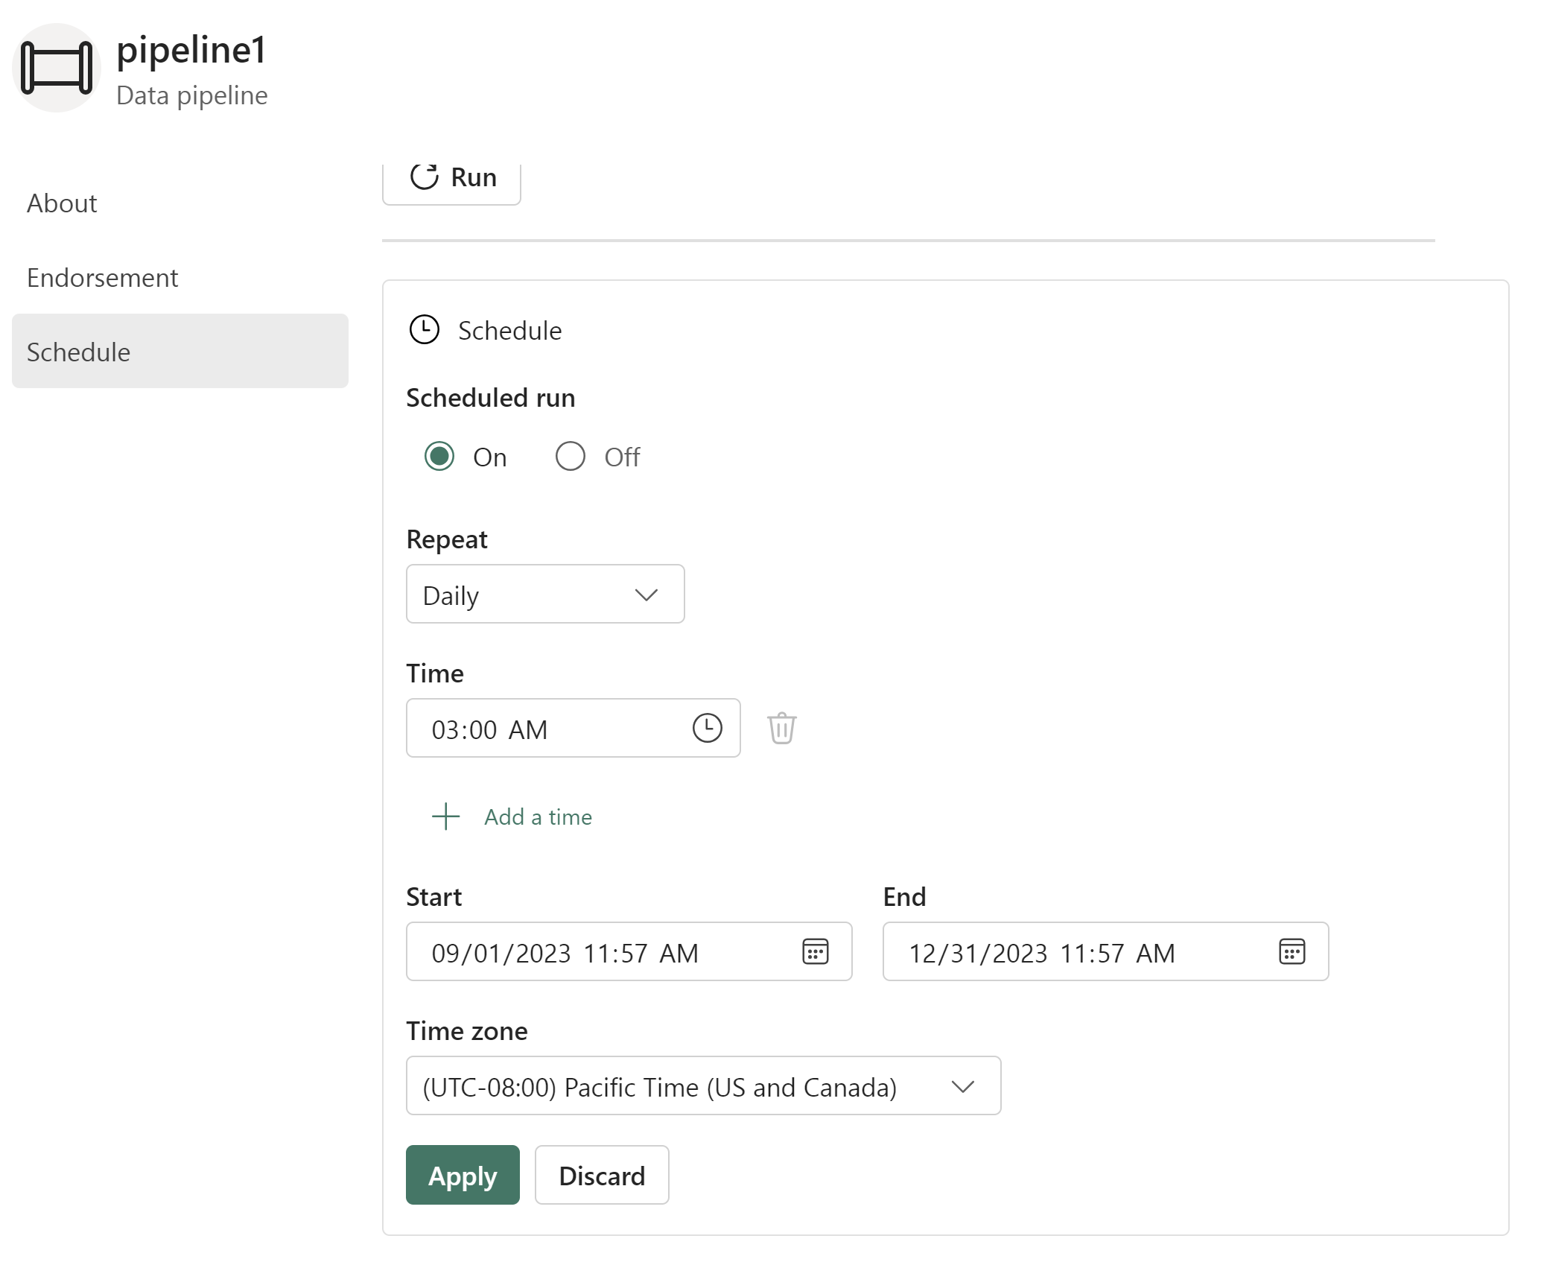
Scheduling data pipelines
Notes:
After completing a pipeline, you can schedule it using the Schedule button on the Home tab. You can choose how often and what time it runs. You can also choose start and end times as well as the time zone on which the schedule runs the pipeline. This can be very helpful in handling daylight savings time.

Slide 12
T-SQL scripts

Slide 13
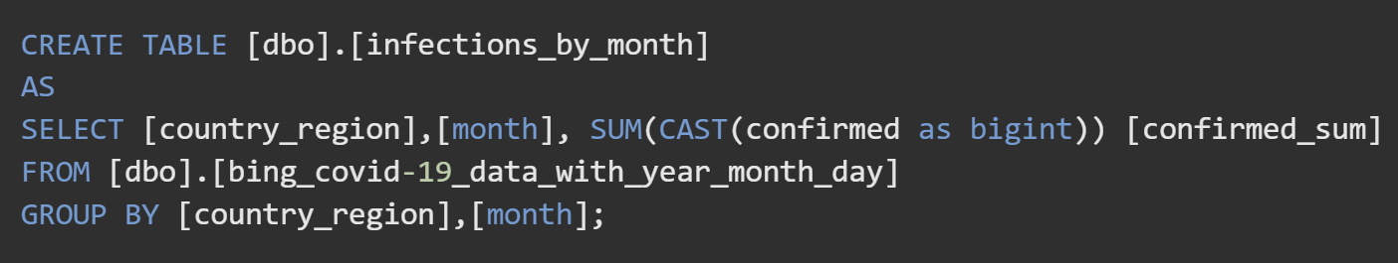
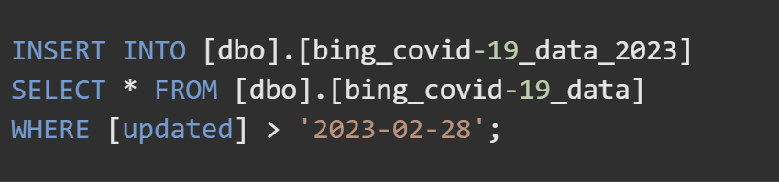
T-SQL
Notes:
You can use T-SQL Create table as select command to create new tables from existing data.
The CREATE TABLE AS SELECT (CTAS) statement allows you to create a new table in your warehouse from the output of a SELECT statement. It runs the ingestion operation into the new table in parallel, making it highly efficient for data transformation and creation of new tables in your workspace.
To insert data into an existing table, you can use Insert Into Select…
Both CREATE TABLE AS SELECT and INSERT...SELECT can be used to load data from another warehouse or lakehouse into your warehouse.

Slide 14
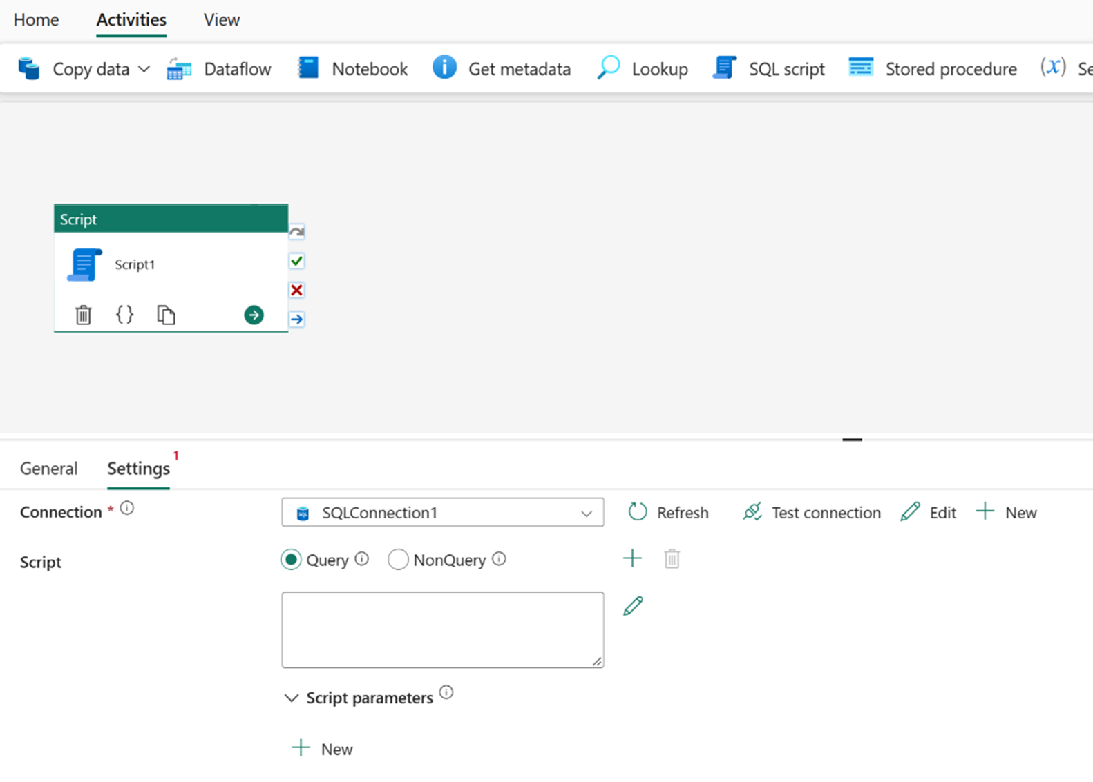
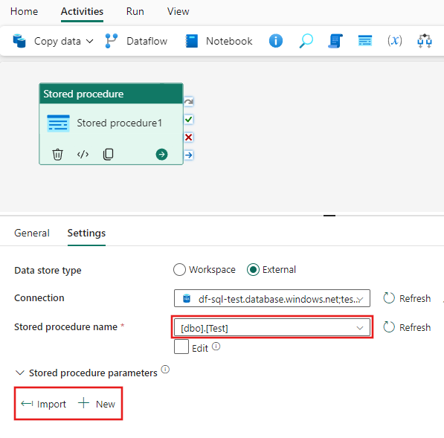
Scheduling T-SQL scripts in Data Pipelines
Script Activity
Stored Procedure Activity
Notes:
Once you have created the SQL commands to populate your table, you can call them from a data pipeline.
There are two options for executing T-SQL on a data warehouse: 1) a script activity and 2) a stored procedure activity
You can take your script and encapsulate it into a stored procedure and just have the data pipeline call that procedure.
Or you can copy your T-SQL script and paste it into the query property of the script activity.
From there, the pipeline is scheduled the same as with the copy activity.

Slide 15
Dataflows

Slide 16
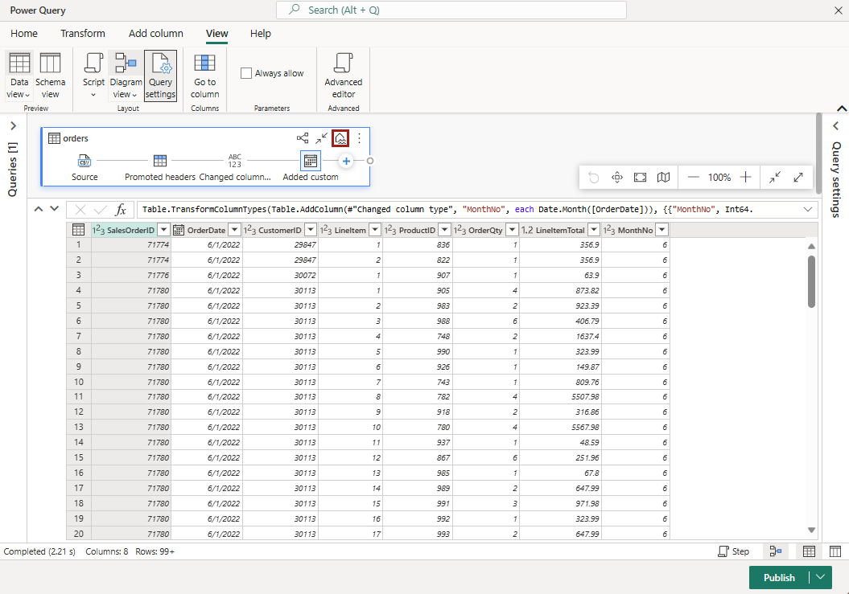
Dataflows
Notes:
In Microsoft Fabric, Dataflows (Gen2) connect to various data sources and perform transformations in Power Query Online. They can then be used in Data Pipelines to ingest data into a lakehouse or other analytical store, or to define a dataset for a Power BI report.

Slide 17
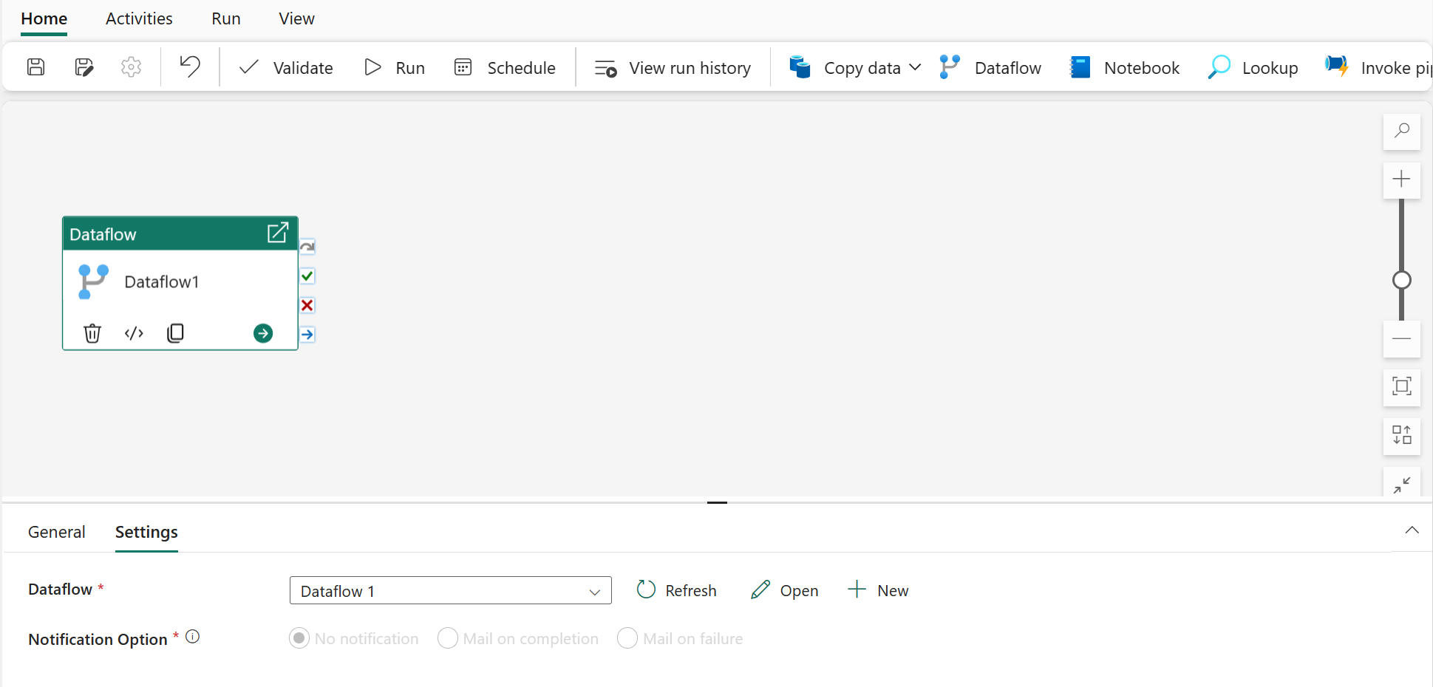
Schedule using a Pipeline
Notes:
When you add a dataflow activity to a pipeline, you choose the dataflow and the notification options. The notification option allows you to author an email and specify the recipients.
Once your pipeline is complete, you schedule it as you would any other data pipeline in Fabric, as discussed before.

Slide 18
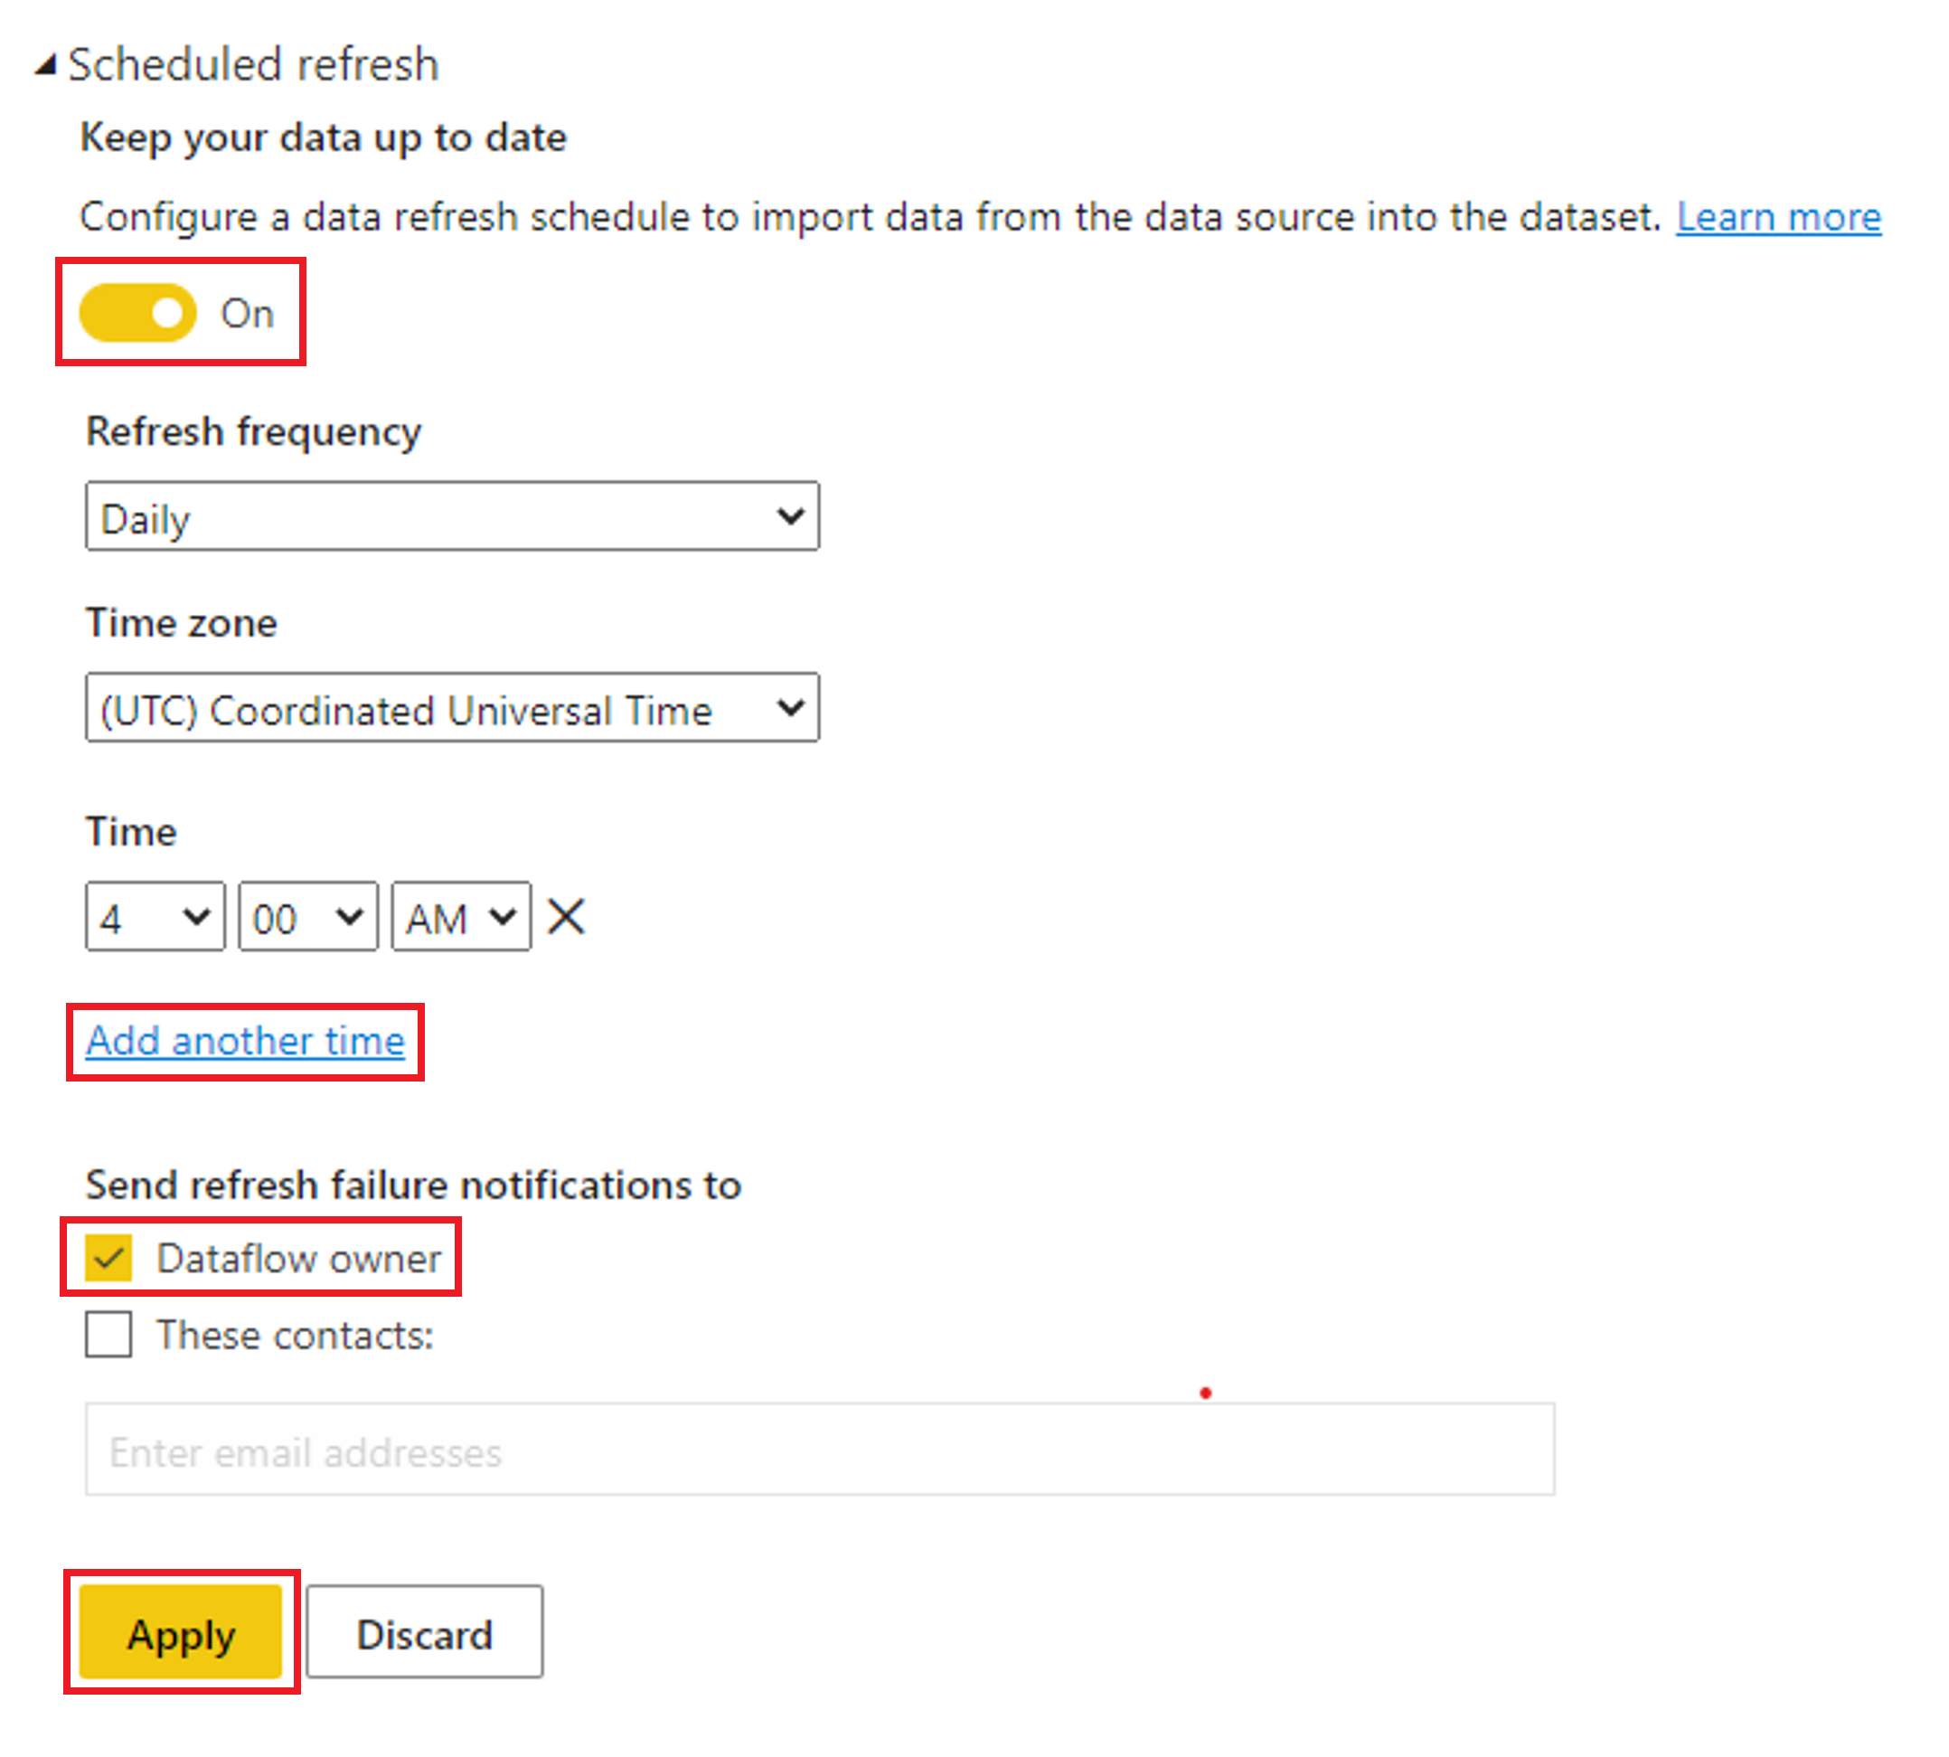
Directly Schedule a Dataflow
Notes:
You can also directly schedule a dataflow without using a pipeline.
In the workspace where the dataflow is published, there will be a schedule icon next to the dataflow. Clicking that icon opens the dialog you see here, where you can enable scheduled refresh. Choose the frequency, time zone, time(s), and who to notify in case of failure. Clicking apply publishes the schedule.

Slide 19
Notebooks

Slide 20
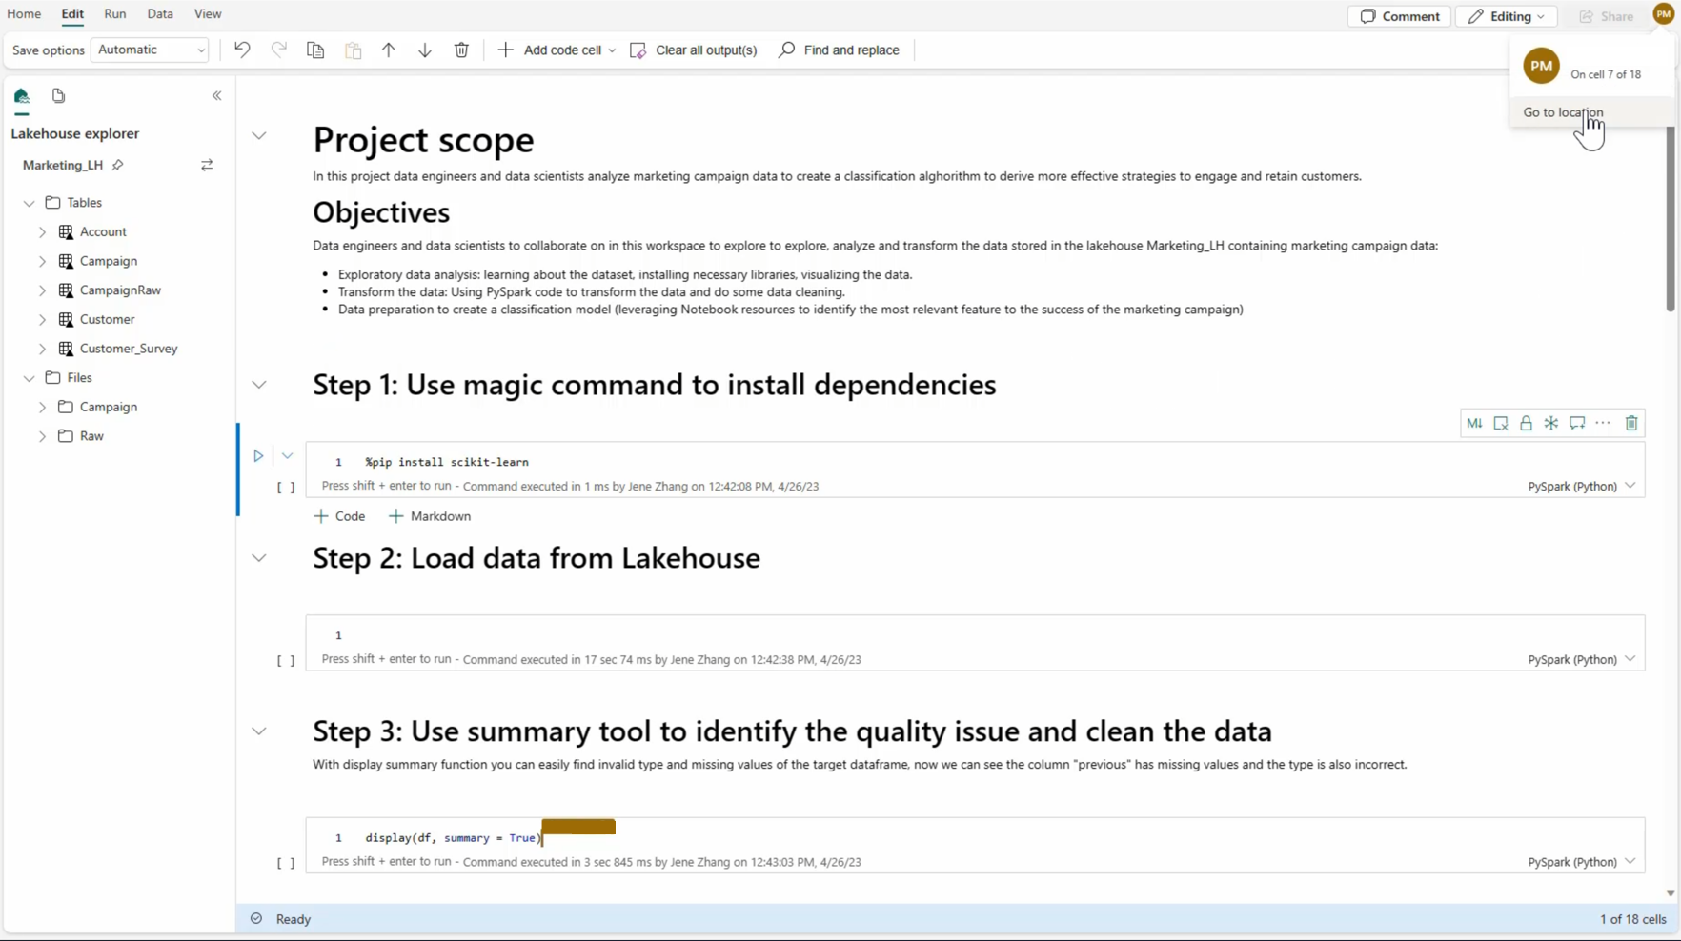
Spark Notebooks
Notes:
Microsoft Fabric notebook is a primary code item for developing Apache Spark jobs and machine learning experiments, it's a web-based interactive surface used by data scientists and data engineers to write code benefiting from rich visualizations and Markdown text. Data engineers write code for data ingestion, data preparation, and data transformation. Data scientists also use notebooks to build machine learning solutions, including creating experiments and models, model tracking, and deployment.
Spark notebooks support analyzing data across raw formats (CSV, txt, JSON, etc.), processed file formats (parquet, Delta Lake, etc.), leveraging powerful Spark capabilities.
Set a primary language
Microsoft Fabric notebooks currently support four Apache Spark languages:
PySpark (Python)
Spark (Scala)
Spark SQL
SparkR
You can set the primary language for new added cells from the dropdown list in the top command bar.
Use multiple languages
You can use multiple languages in a notebook by specifying the language magic command at the beginning of a cell, you can also switch the cell language from the language picker. The following table lists the magic commands to switch cell languages.

Slide 21
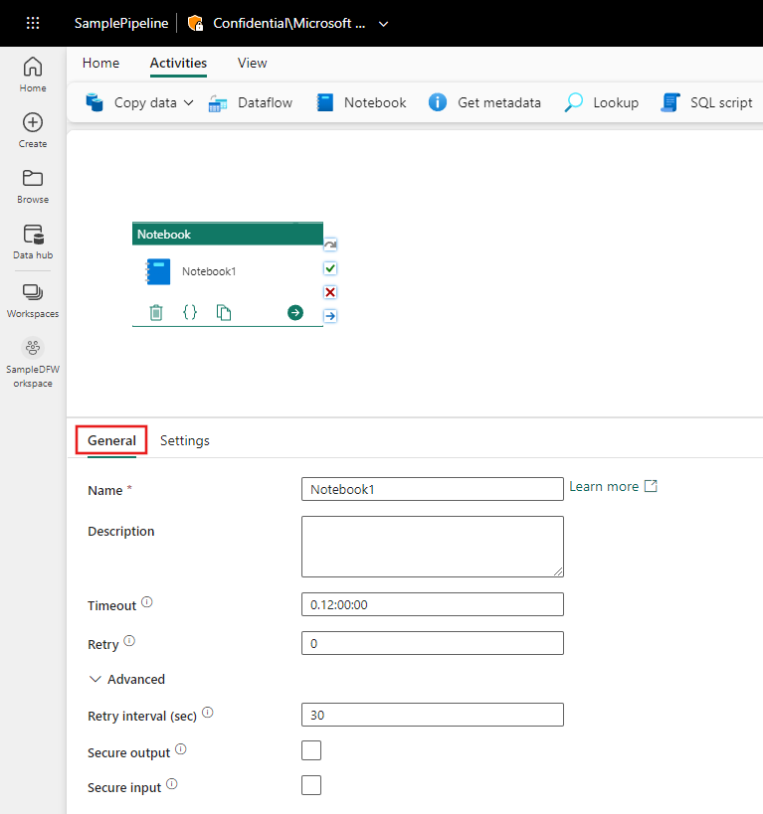
Schedule using a Pipeline
Notes:
The Notebook activity in pipeline allows you to run Notebook created in Microsoft Fabric.. You can select the notebook and configure parameters to pass in for execution. The general settings for the activity allow you to set retries, timeouts, and more.
Once you have added the Notebook activity, you can schedule the pipeline as with any other data pipeline.

Slide 22
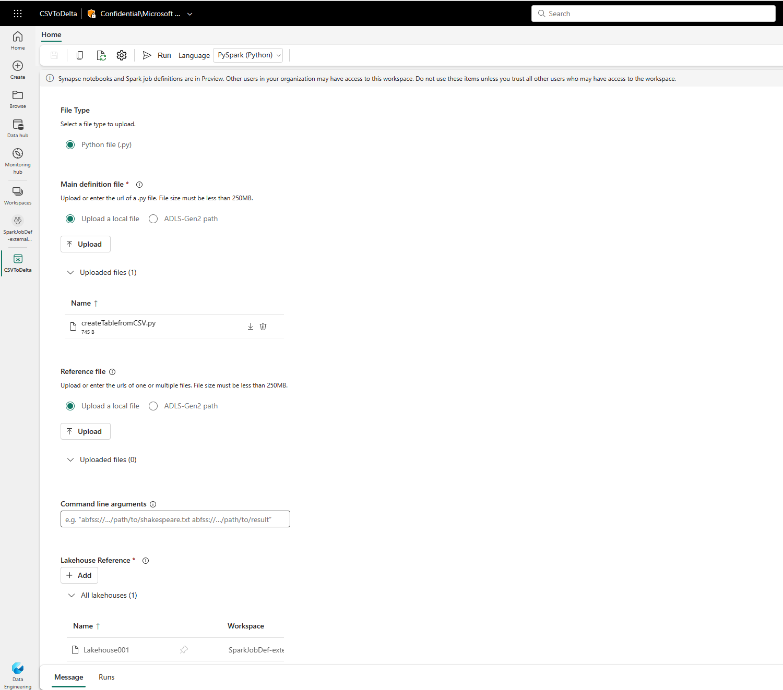
Create a Spark Job Definition
Notes:
An Apache Spark Job Definition is a Microsoft Fabric code item that allows you to submit batch/streaming job to Spark cluster. By uploading the binary files from compilation output of different languages, .jar from Java for example, you can apply different transformation logic to the data hosted on lakehouse. Besides the binary file, you can further customize the behavior of the job by uploading additional libraries and command line arguments.
To run a Spark job definition, you must have at least one lakehouse associated with it. This default lakehouse context serves as the default file system for Spark runtime. For any Spark code using relative path to read/write data, the data is served from the default lakehouse.
There are a few ways you can get started with the creation process:
Data engineering homepage: You can easily create a Spark job definition through the Spark job definition card under the New section in the homepage.
Workspace view: You can also create a Spark job definition through the Workspace view when you are on the Data Engineering experience by using the New dropdown.
Create Hub: Another entry point to create a Spark job definition is in the Create Hub page under Data Engineering.

Slide 23
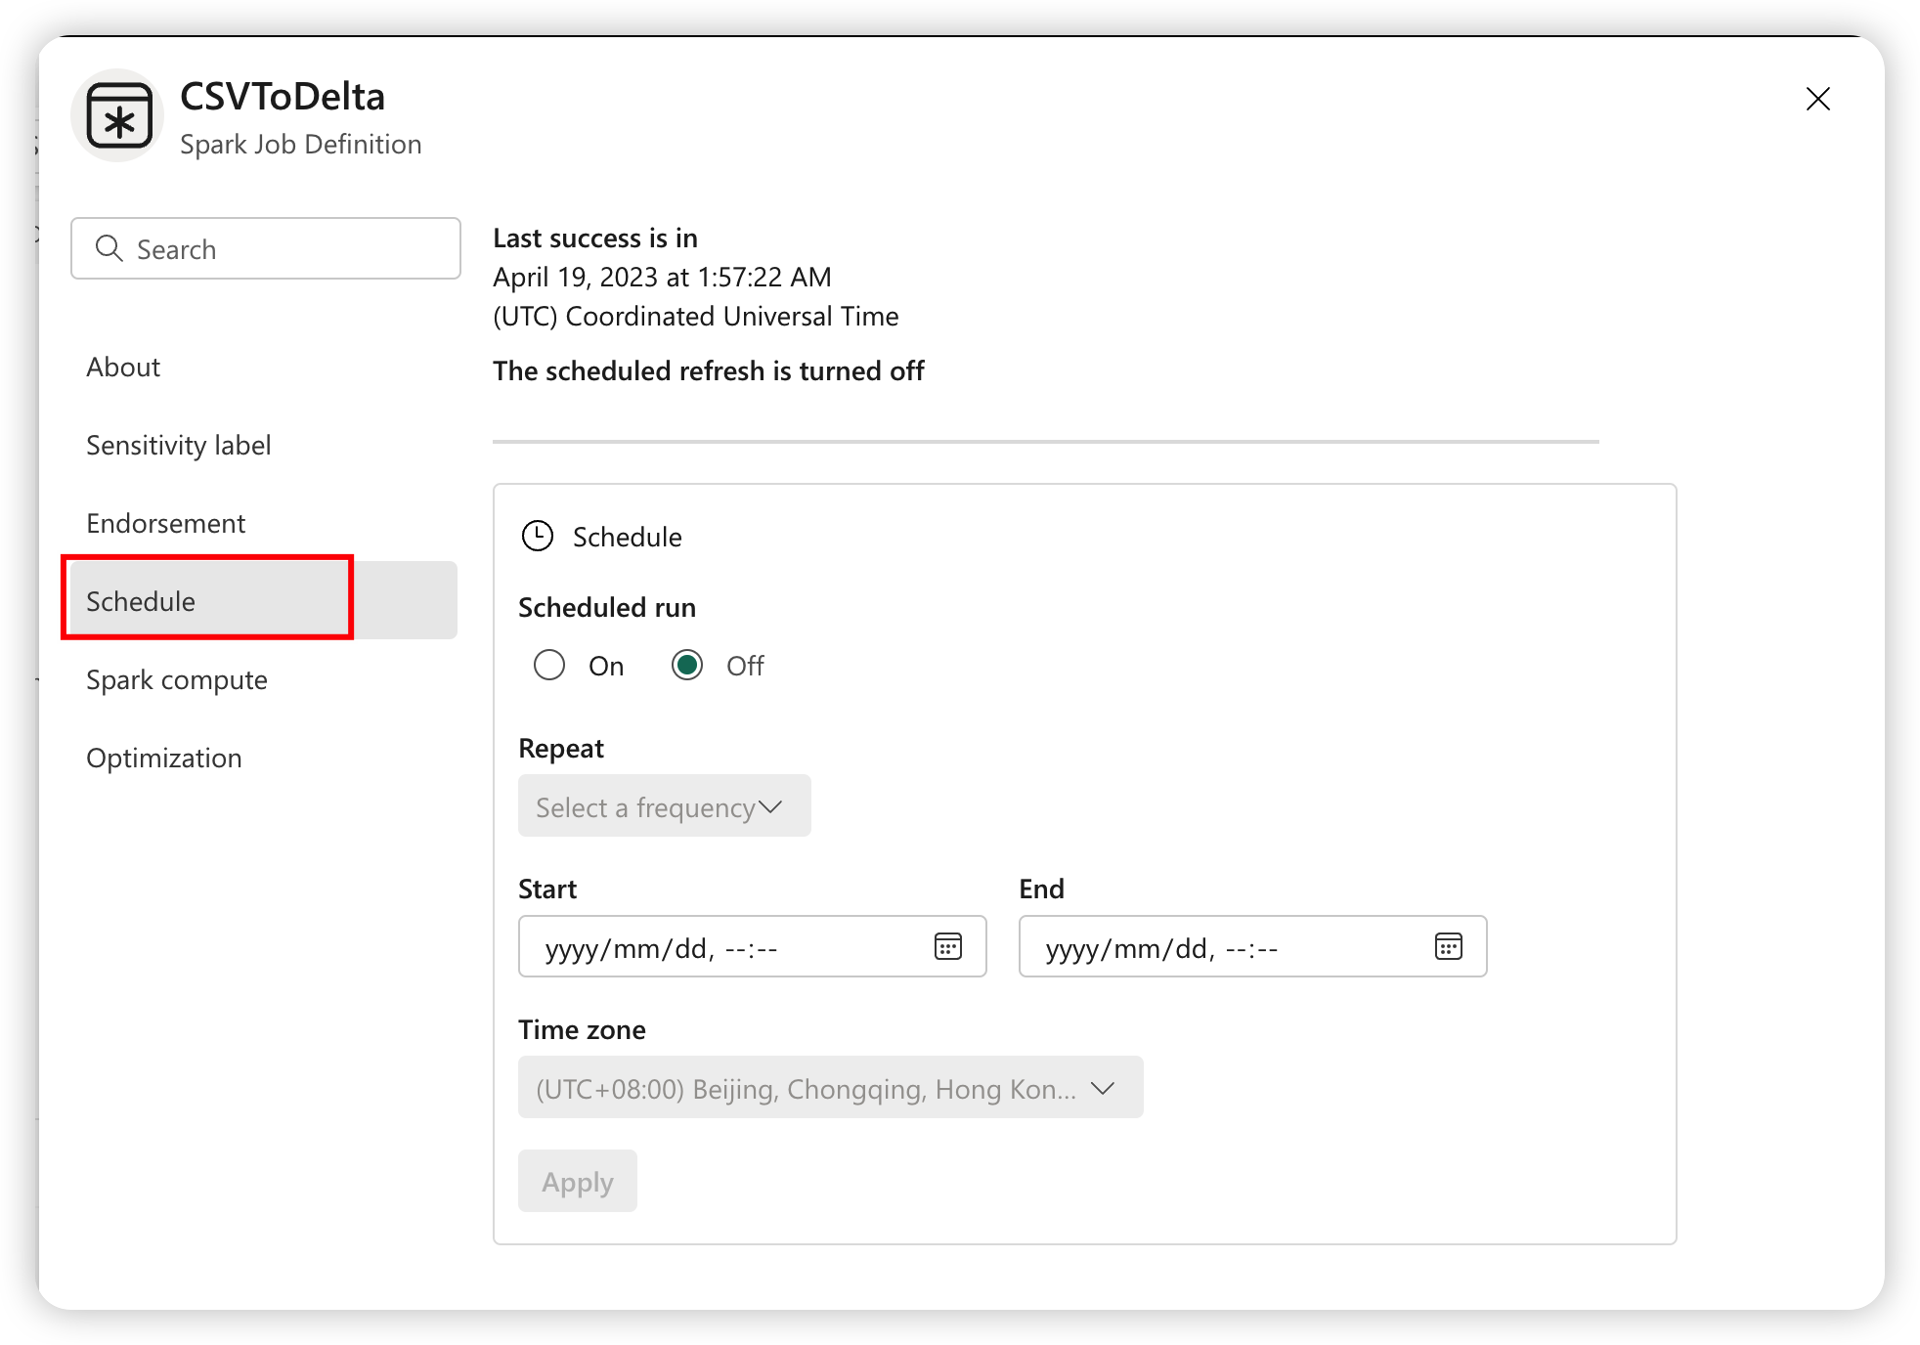
Schedule a Spark Job Definition
Notes:
While you can run a Spark job definition on an ad hoc basis, you will likely want to schedule repeatable processes. To run a Spark job definition, it must have the main definition file and the default lakehouse context.
Schedule a Spark job definition item by setting up the schedule plan under the Settings tab.
You can turn the schedule on or off, select a frequency, set the start and end dates and choose a time zone.

Slide 24
Summary
You can use data pipelines, dataflows, Spark notebooks, Spark job definitions, and T-SQL to ingest and transform data
The best option depends on transformation needs, the amount of code you want to write, the size of the data
Dataflows and Spark job definitions can be scheduled independently.
Notebooks and dataflows can be added to a data pipeline for scheduling

Slide 25

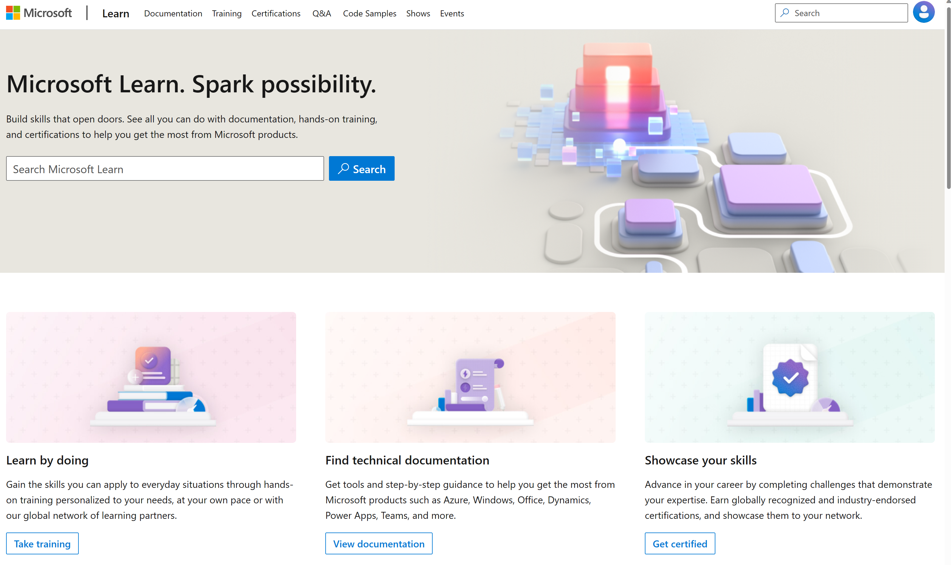
Microsoft Learn Demo
Microsoft Learn: Build skills that open doors in your career

Slide 26
Readiness and Enablement Links
The Microsoft Federal Team is here to help you accelerate customers' digital transformation. Microsoft Federal has tailored to make your organizations skilling journey successful. From the Business Decision Maker to the technical community and end-users, Microsoft provides customers with access to endless skilling resources. Below you will find links to these resources:
Get training tailored to your organization's needs: Find learning paths for specific roles in your organization, plus course recommendations based on technology, skill level, and solution area: Training | Learning Portal (microsoft.com)
Events Calendar - US Partner Community Blog – Microsoft
In addition to the above, the Microsoft Federal Team can address the needs of your non-technical community of your learners through:
Skilling Hours - Readiness and Enablement: Skilling our Federal Customers and Partners (office.com)
Microsoft Learning Portal: A closer look at Azure through training modules and gamified learning
Microsoft Learning Portal
Additional Learning Resources:
Get started with Azure – Introduction | Microsoft Azure
Microsoft Learn (path-based)
Exam-based: Select filters: Azure, D365, M365, Power Platform, and more
Microsoft Virtual Training Days – Virtual Instructor Led
Microsoft Technology Center - Work through your Account Manager
Home - Microsoft Tech Community
Microsoft Reactor | Microsoft Developer – Virtual Instructor Led

